Slide 1

Research Based Learning
Guide:
Dr. Vani V
Presenter:
Akshay Kumar Yadav
20MCB1015

Slide 2

Effective Deep Learning Model using Twitter Records

Slide 3
oBJECTIVE
The objective of this Research is to perform sentimental analysis using social media platform twitter.

Slide 4
Abstraction
Now a days sentimental analysis is widely used to understand and interpret the opinion, speculations and reaction of the population. Sentimental analysis helps in identifying the reaction of people towards a topic, person or brand which helps in improving brand image, updating strategies, and knowing the customers demands and needs. The objective of this paper is to perform sentimental analysis using social media platform twitter.

Slide 5

Deep Learning
Deep learning is an AI function that mimics the workings of the human brain in processing data for use in detecting objects, recognizing speech, translating languages, and making decisions.
Deep learning is able to learn without human supervision, drawing from data that is both structured or unstructured and labeled or unlabeled.
Deep learning, a form of machine learning, can be used to help detect fraud or money laundering, NLP tasks among other functions.

Slide 6
EXISTING MODEL
Dataset(Tweets)
Pre-processing
Transformation
Classification
Simple RNN(Accuracy-75.18)
Single LSTM (Accuracy-80.34)
Bidirectional LSTM (Accuracy-76.34
1D CNN (Accuracy-81.34
Evaluation

Slide 7

Drawbacks of Existing Model
Most of the sentiment classification models are based on machine learning.
They tends to give low accuracy in comparison to deep learning models.
Machine learning models sometimes give less accuracy for the large dataset.

Slide 8
Flow of the Model
Input dataset.
Preprocessing of the dataset.
Splitting dataset into training and test dataset.
Training model
Testing model

Slide 9
Algorithms Used
Simple RNN
LSTM
Bidirectional LTSM
1D convolutional

Slide 10
Required Software
Jupyter notebook

Slide 11
Dataset Details
Dataset was taken from kaggle
It contains 27481 tweets
Positive tweets – 8582
Negative tweets – 7781
Neutral tweets - 11118

Slide 12
Dependencies
Tensorflow
Matplotlib
Nltk
Genism
Numpy
Pandas
Sklearn

Slide 13
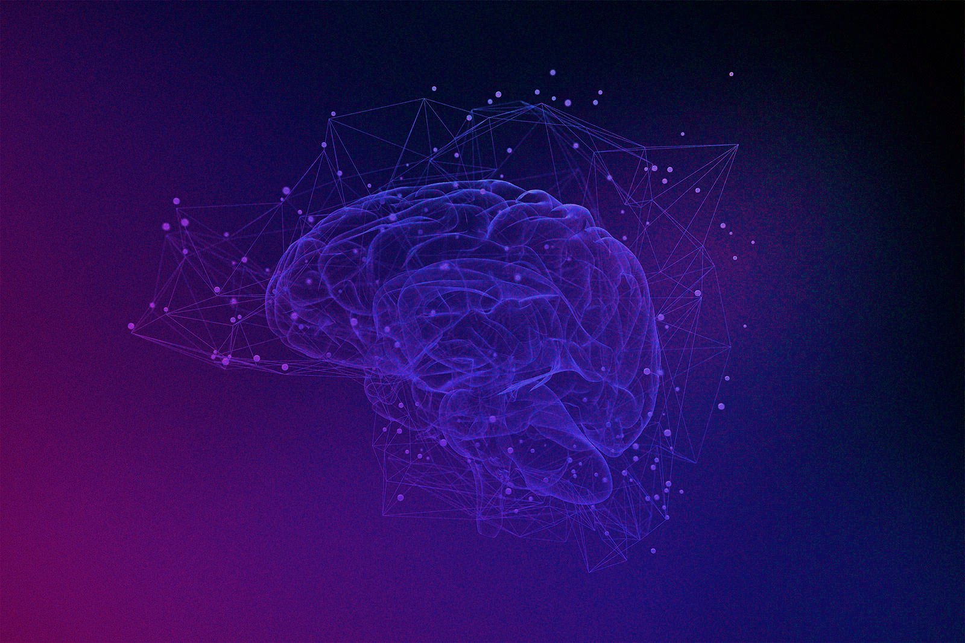
Proposed Architecture
Dataset(Tweets)
Pre-processing
Transformation
Hybrid CNN-LSTM
Evaluation(Accuracy-84.56)

Slide 14
Applications
Helps in decision making.
Opinion mining.
Band monitoring.
Providing better product analytics

Slide 15
Result of existing Models Applied
Simple RNN Model (Accuracy achieved- 75.18%)
Single LSTM Layer Model (Accuracy achieved- 80.34%)
Bidirectional LTSM (Accuracy achieved- 76.11 %)
1D convolutional (Accuracy achieved- 81.34%)

Slide 16
Result of Proposed Model
Hybrid CNN-LSTM (Accuracy achieved- 84.56%)

Slide 17
Conclusion
The model proposed in this paper gives the better accuracy in comparison to the other existing models. Therefore, sentimental analysis can be very useful for determining the views and emotions of the public about various trending topics (i.e. Business, products, politics).There are various machine learning models and deep learning models used to analyse and interpret the sentiments.

Slide 18
Future Work
In future we can also include emoticons or emojis for sentimental analysis and different languages other than English can also be used for classification.

Slide 19

Thank You

